Slide 1
Product and Credentials NFT Platform for Businesses
Akshat Gadodia (19ESKCS021)
Akshita Sharma (19ESKCS027)

Slide 2
Introduction
Welcome to the presentation on the Product and Credentials NFT Platform for Businesses. This project aims to revolutionize traditional systems by leveraging Non-Fungible Tokens (NFTs) to ensure efficient management of products and documents. NFTs are unique digital assets stored on a blockchain, providing individual ownership and authenticity verification. By incorporating NFTs into the management process, we can overcome challenges such as counterfeiting, fraud, and inefficient tracking.
Throughout this presentation, we will explore the objectives, problem statement, system architecture, features, and benefits of the Product and Credentials NFT Platform for Businesses. By the end, you will understand how this innovative system enhances security, transparency, and efficiency.

Slide 3
Objectives
The Product and Credentials NFT Platform for Businesses aims to enhance security, streamline tracking and verification, improve document management, facilitate compliance, and foster trust and transparency. By leveraging NFTs and blockchain technology, the system ensures secure and authentic product and document data, enables efficient tracking and verification, provides seamless document management with authentication and secure sharing, facilitates compliance with regulatory requirements, and fosters trust through transparent and immutable records. These objectives revolutionize the management process, delivering enhanced security, efficiency, and transparency for organizations in various industries.

Slide 4
Problem Statement
The traditional product and document management systems face several challenges that can be addressed by implementing the Product and Credentials NFT Platform for Businesses. These challenges include:
Counterfeiting and fraud risks in the supply chain.
Inefficient tracking and verification of product authenticity.
Lack of transparency and difficulty in maintaining document integrity.
Compliance issues due to inadequate audit trails.
By leveraging NFTs and blockchain technology, our system provides solutions to these challenges, ensuring enhanced security, efficient tracking, transparent document management, and robust compliance measures.

Slide 5
System Architecture
The Product and Credentials NFT Platform for Businesses consists of four key components. First, the user interface offers a user-friendly platform for creating, viewing, and sharing NFTs.
Second, the decentralized blockchain network ensures secure and immutable storage of product and document data.
Third, the NFT smart contract defines the rules governing NFT creation, ownership, transfer, and verification.
Finally, off-chain storage facilitates efficient document management, including version control and secure sharing, while preserving the integrity of the audit trail.
Together, these components create a robust system for secure, transparent, and efficient product and document management.

Slide 6
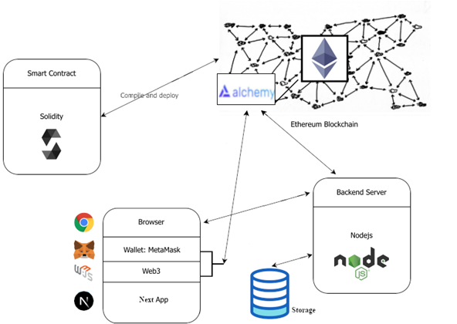

Slide 7



Features and Functionality
The Product and Credentials NFT Platform for Businesses offers a range of features and functionalities. It enables seamless product tracking and verification using NFTs, ensuring the authenticity and provenance of goods throughout the supply chain. Additionally, the system provides efficient document management and authentication using NFTs, allowing for secure storage, version control, and sharing of important documents. Users can easily access and verify the validity of product and document information, while organizations benefit from increased security, transparency, and streamlined management processes. This system revolutionizes product and document management, mitigating fraud, improving efficiency, and enhancing trust.

Slide 8
Use Cases
The Product and Credentials NFT Platform for Businesses has diverse applications across industries. In the manufacturing sector, it can ensure supply chain integrity, preventing counterfeiting and ensuring product authenticity. In the healthcare industry, it can streamline the management of patient records, enabling secure sharing and verification. Intellectual property rights protection can be enhanced by using NFTs to authenticate and track ownership of creative works. Moreover, the system can be applied to logistics and shipping, luxury goods, and legal document management. These use cases highlight the versatility and value of the Product and Credentials NFT Platform for Businesses in various domains.

Slide 9
Technical Implementation
The Product and Credentials NFT Platform for Businesses leverages blockchain technology and smart contracts for its technical implementation. The system integrates with a blockchain network to store NFTs securely and immutably. Smart contracts are utilized to define the rules and logic governing NFT creation, ownership, and verification. The implementation includes developing a user-friendly interface for seamless interaction with the system. Additionally, off-chain storage solutions are integrated to efficiently manage documents while preserving the integrity of the audit trail. This technical infrastructure ensures the robustness and reliability of the Product and Credentials NFT Platform for Businesses.

Slide 10
Benefits
The Product and Credentials NFT Platform for Businesses offers several key benefits. Firstly, it enhances security by leveraging blockchain technology and NFTs to ensure the integrity and authenticity of products and documents. Secondly, the system improves efficiency by enabling streamlined tracking, verification, and management processes. Thirdly, it reduces the risk of fraud and counterfeit products, safeguarding the interests of businesses and consumers. Additionally, the system provides transparency and trust through easily accessible and verifiable records. Overall, the Product and Credentials NFT Platform for Businesses revolutionizes traditional systems, offering enhanced security, efficiency, and transparency for organizations across industries.

Slide 11
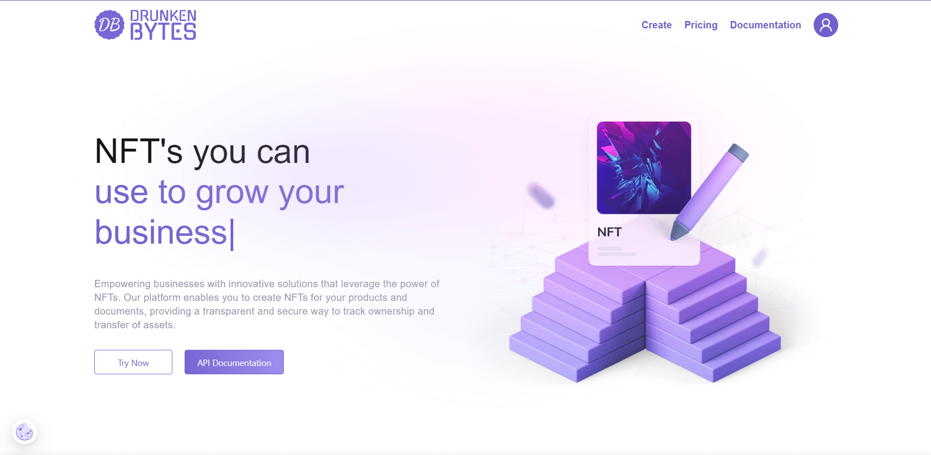
Home Page

Slide 12
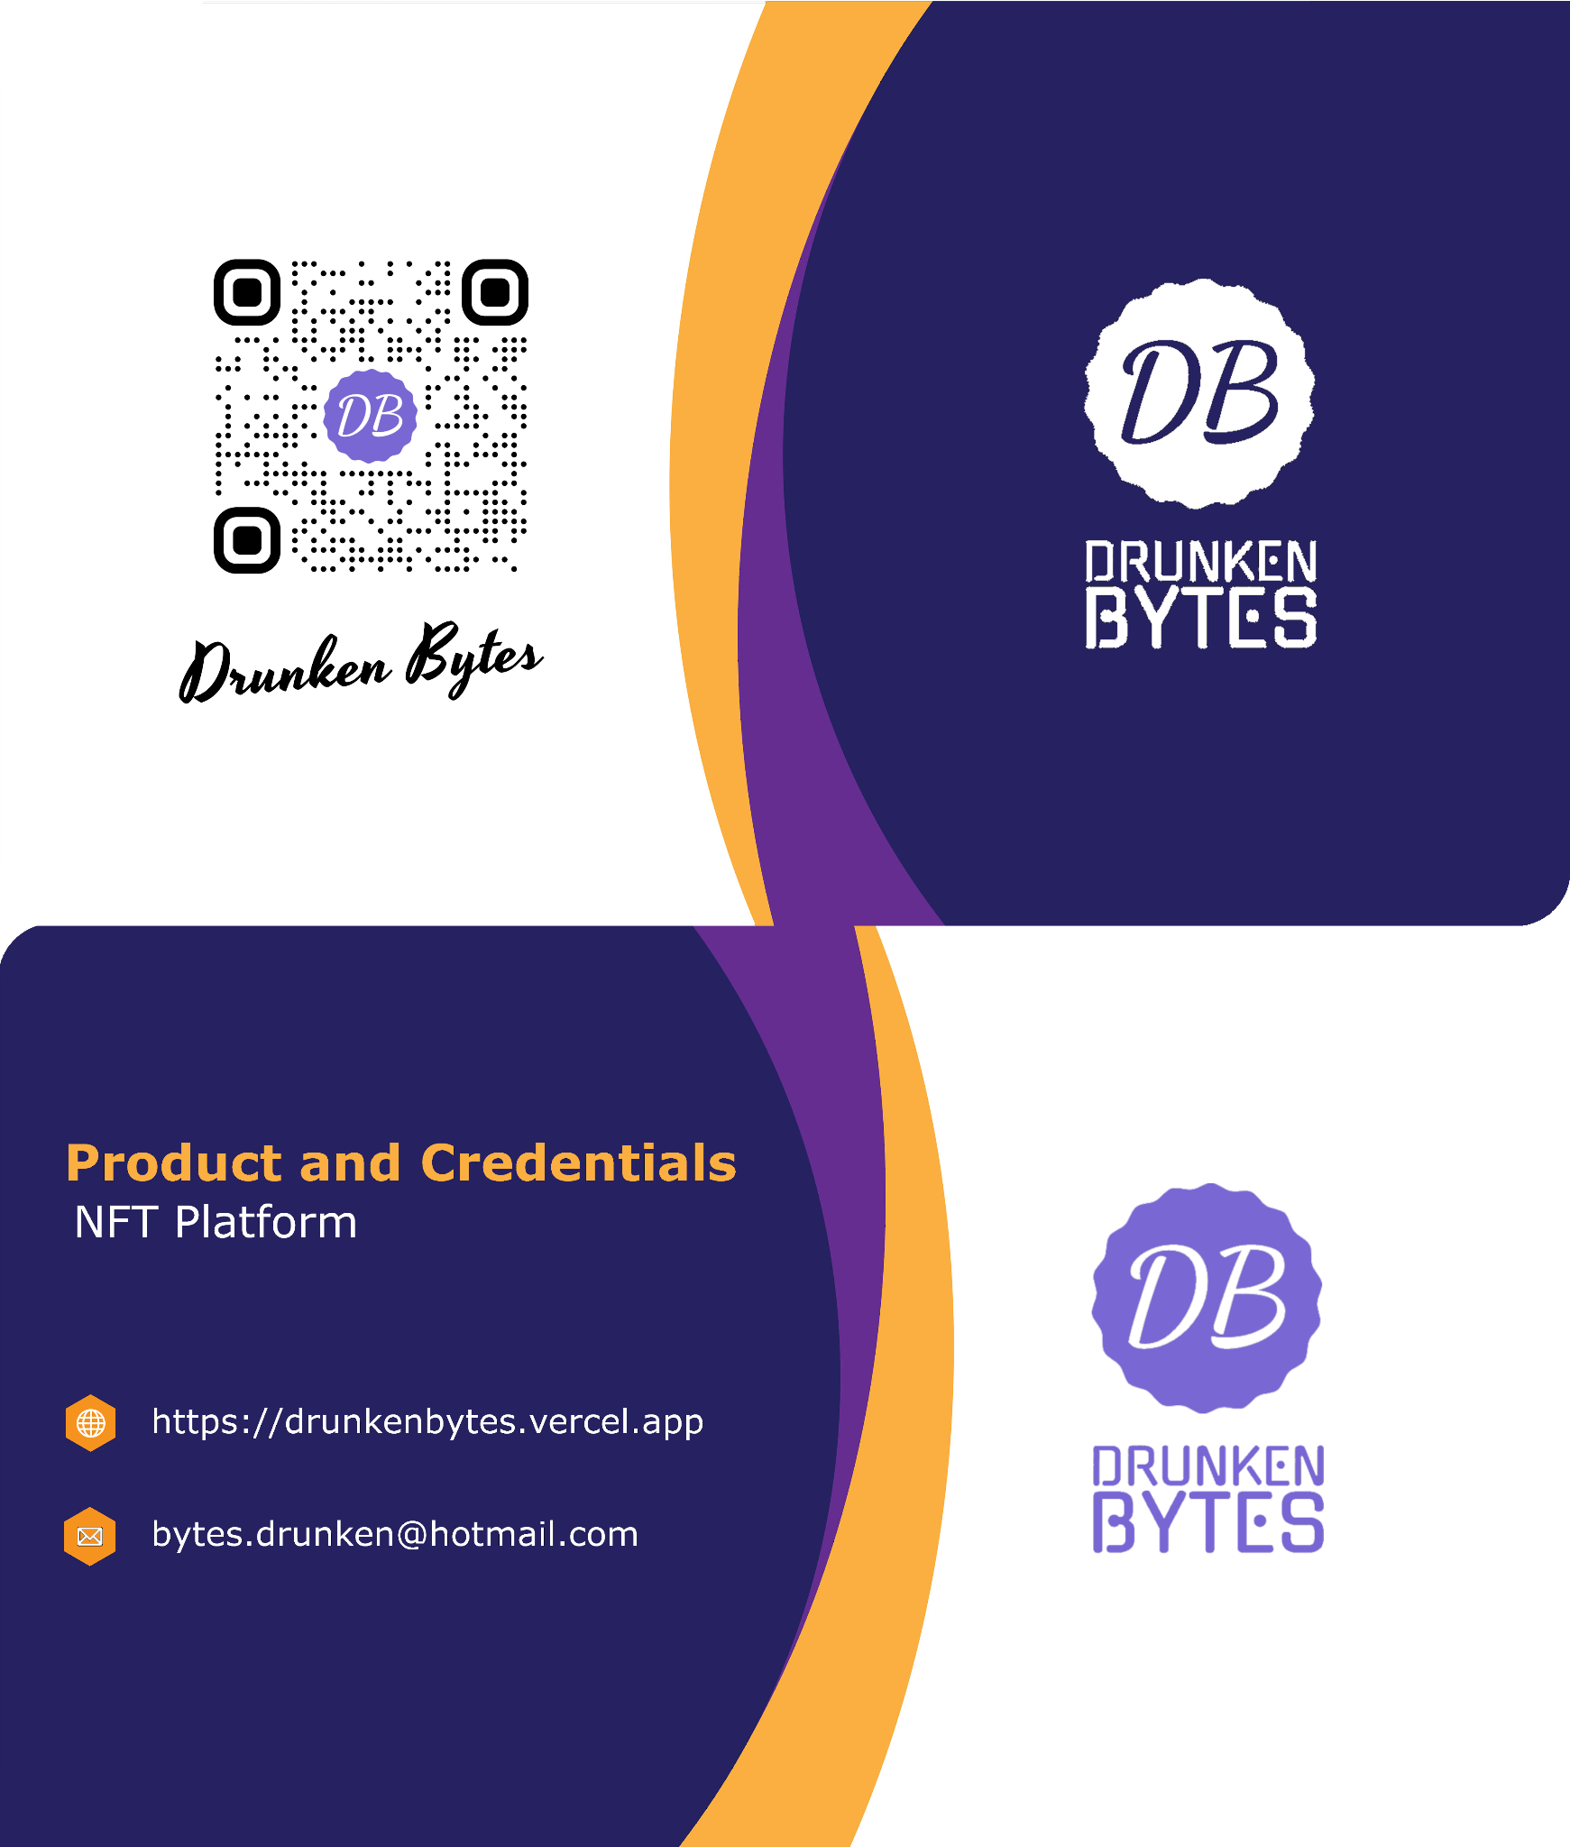
Default Image of NFT

Slide 13
Future Scope
The Product and Credentials NFT Platform for Businesses has a promising future with potential scope for further enhancements. One potential development is the integration with Internet of Things (IoT) devices, enabling real-time tracking and monitoring of products. This would further enhance supply chain visibility and transparency. Additionally, the system can expand its application to other industries, such as art and collectibles, real estate, and digital rights management. Continual advancements in blockchain technology and smart contracts offer opportunities for further innovation and optimization of the system. The future holds immense potential for the Product and Credentials NFT Platform for Businesses to revolutionize various industries and processes.

Slide 14
Conclusion
In conclusion, the Product and Credentials NFT Platform for Businesses represents a revolutionary approach to managing products and documents. By leveraging the unique properties of NFTs and blockchain technology, the system addresses the limitations of traditional systems, offering enhanced security, efficiency, and transparency. It provides seamless tracking and verification of products, efficient management of documents, and robust compliance measures. The system's wide-ranging applications across industries make it a valuable solution for organizations seeking to streamline their operations and enhance trust among stakeholders. Implementing the Product and Credentials NFT Platform for Businesses brings tangible benefits and paves the way for a more secure and transparent future.

Slide 15
Thank you!
Thank you for being a part of this presentation on the Product and Credentials NFT Platform for Businesses. We appreciate your time and engagement. If you have any further questions or would like to explore this topic in more detail, please feel free to reach out to us. We look forward to hearing from you and discussing how this innovative system can benefit your organization. Thank you once again for your participation.

